Slide 1


- BioLabSim - Data Literacy in Biotechnology with Virtual Organisms
Ulf Liebal
Institute of Applied Microbiology RWTH Aachen University
25.05.2021

Slide 2
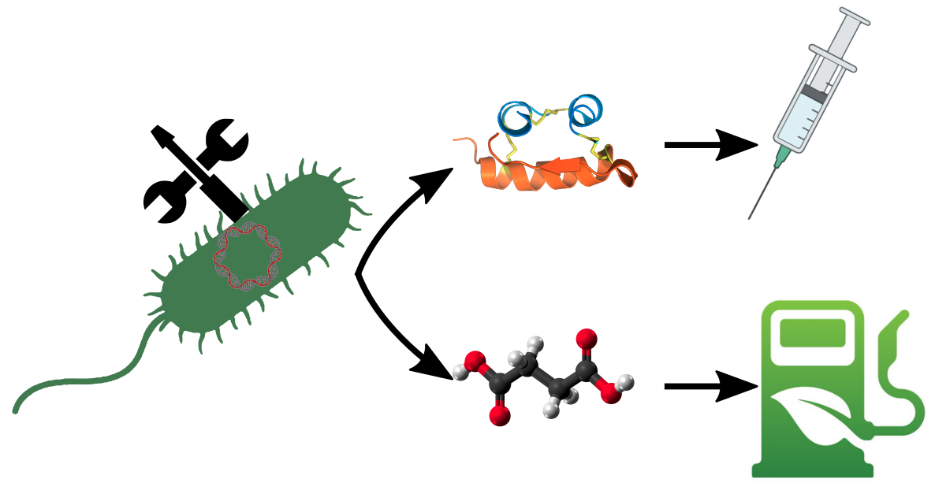
Many Steps to Success in Biotechnology
Product choice: speciality compound (e.g. vaccines) bulk chemical (e.g. biofuels)
Life science knowledge to select a suitable host (bacteria, yeast).
Molecular engineering to modify genome and metabolome structure.
Process engineering to optimize fermentation and product recovery.
Problem:
Each step requires computational and data analysis skills.

Slide 3
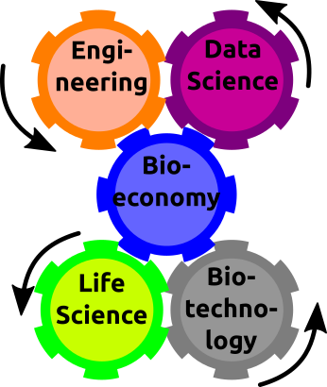




Exclusive Competencies between Life and Data Science
Problem:
Experts missing with skills covering Data Science and Life Science.
Experts needed for Life Science & Biotechnology, Engineering & Data Science.
The required skills are trained in separate domains – e.g. Life and Data Science.

Slide 4





Engaging Training of Life Scientist on Data Science
Program language skills (Python)
Modern data analysis (Jupyter Notebooks)
Relevant and realistic data
(Complex and high throughput)
Motivating learning stories
(Vaccine development)
Simulation budget constrains
(Resource optimization)

Slide 5


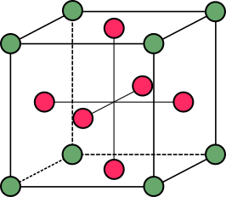
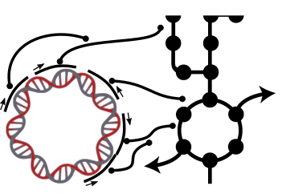
The BioLabSim Environment for Educational Simulations
RecExpSim
SeqDatSim
Educational Resources
Core Operation System
FermProSim
MetEngSim

Slide 6



Overview: Biology Operating System in Python
Python code: with active (bio-)science community (e.g. biopython, cobrapy)
GitLab based: version management and project development
Open source (soon): individual code adjustments
Pip installation: easy download and integration into Python environment

Slide 7

Biology-Operating-System
Rafael Schimassek
Virtual organism simulation requirements:
Fast
Realistic
Cloud-based

Slide 8
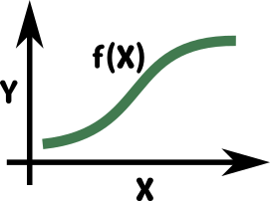



Virtual Organism Setup
Model/Regressor function
dependent variable
independent variable
Mechanistic Modeling
Growth: Logistic model
Metabolic rate: Flux balance analysis
Enzyme activity: Michaelis-Menten
Machine Learning
Gene expression: Random Forest
Random events
Optimal temperature
Maximum biomass
Genome sequence

Slide 9
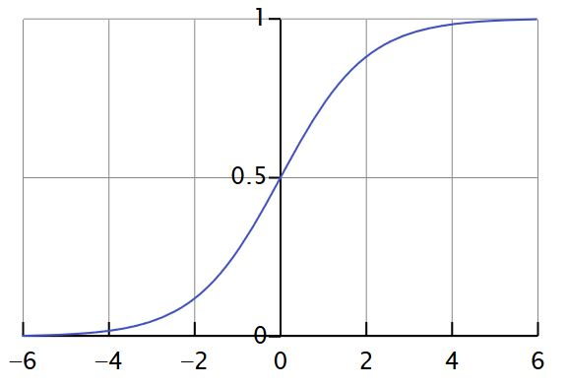
Biomass Prediction with the Logistic Function
Logistic Function – self-limiting Growth of a Biological Population Originally due to Verhulst
P(t) = biomass conc. after t hours [g/L]
K = maximum biomass conc. [g/L]
P₀ = biomass conc. of inoculum [g/L]
r = growth rate (temperature-dependent) [ /h ]
t = time [h]
source: https://en.wikipedia.org/wiki/Logistic_function

Slide 10

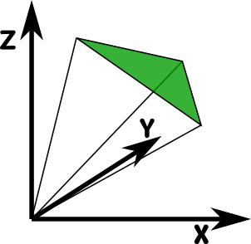
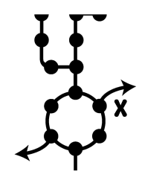


Linking Genome and Metabolism
Flux Balance Analysis
Flux(X_{W})
Flux(X_{W}) = Expr2Flux(X)*Expr(X_{W})
Flux(X_{M}) = Expr2Flux(X)*Expr(X_{M})
Gene X:
Genome Scale Metabolic Model
ORF
σ⁷⁰-promoter
Expr(X_{W})
Random Genome
Expression
Prediction

Slide 11




Educational Training Features
Cloud based: no requirements on hard- and software
General purpose file format: free choice of data analysis tool
Jupyter Notebooks: integration of code, comments, and visualization
Independent access: group learning or self-learning strategies possible

Slide 12

RecExpSim
Iris Broderius
Data analysis training:
Growth curve analysis
Promoter library construction

Slide 13
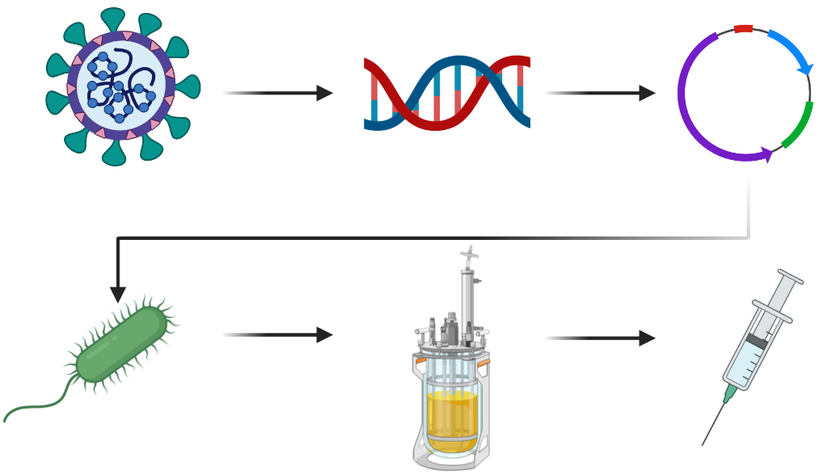
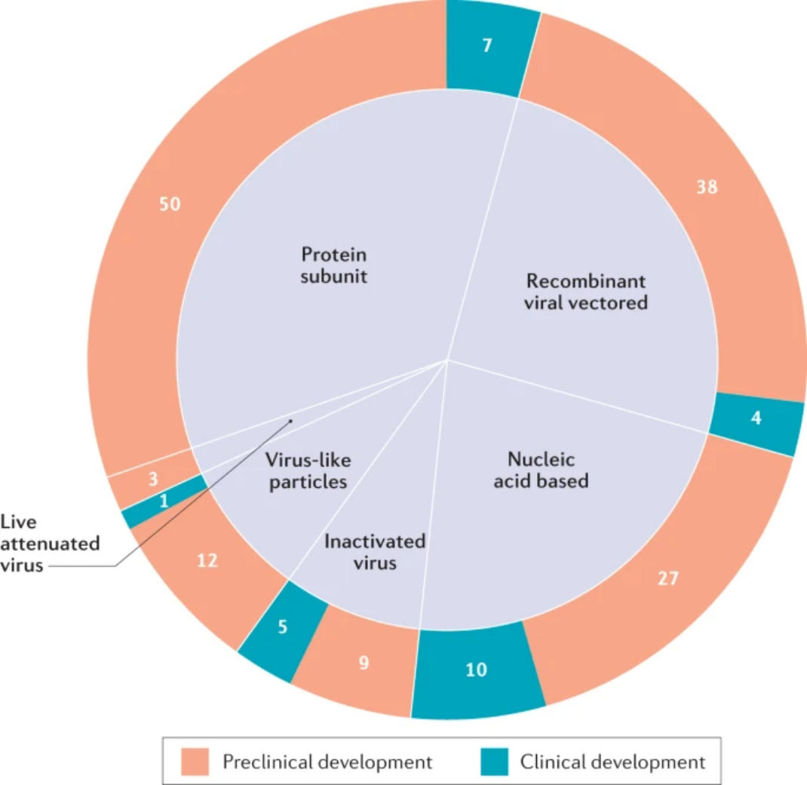
RecExpSim: Simulation of Recombinant Expression
Story:
Develop an expression system for recombinant production of COVID19 protein subunit vaccine.
Jeyanathan et al., 2020, doi: 10.1038/s41577-020-00434-6
1. Characterize two strains for their growth properties
2. Generate promoter sequences
3. Clone promoter sequences into strain
4. Measure expression rate
5. Conduct batch fermentation to harvest protein subunits
The majority of vaccine (candidates) is based on recombinant expression of protein subunits.

Slide 14





RecExpSim: Data Analysis Example
Objective
Optimal
Temperature
Growth Rate &
Max Biomass
Procedure
Analysis
Programming task in popular Jupyter Notebook environment with python commands.
Functions for linear regression, mean calculation provided.
Parsons Problem: Code lines in scrambled order --> Students learn to understand code.
Excel is de-facto standard for quick laboratory data analysis.
Some students will prefer Excel based problem solving.
Students identify suitable linear regression functions.

Slide 15

FermProSim
Jonathan Sturm (BPT, WHS)
Data analysis training:
Design of experiment to identify optimal fermentation parameter

Slide 16
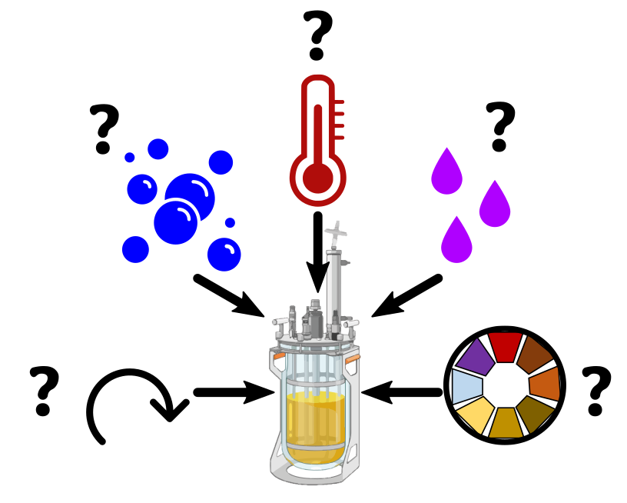
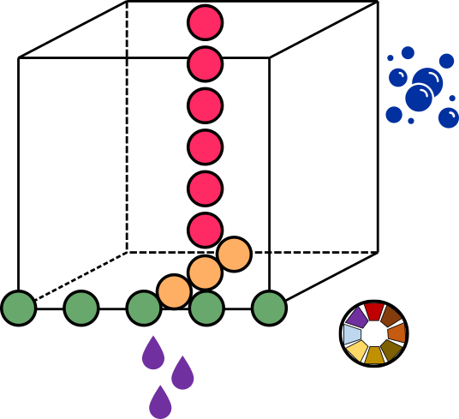
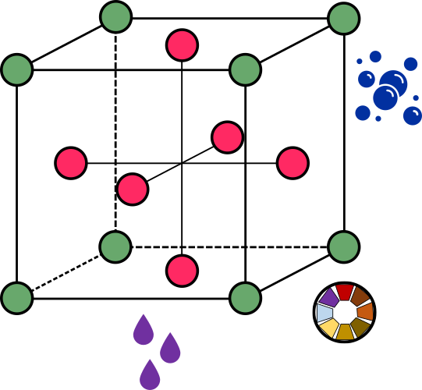
FermProSim: Genome Sequence Identification
Objective
Procedure
Analysis
Multiple dependent factors: biomass, product concentration
Mutliple independent factors: rpm, dO2, Temp, acid/base, pH
Identification of optimal parameter combinations with limited budget

Slide 17




Conclusion & Outlook
State of the art data science training for the life scientist/biotechnologist.
Realistic data generation to test workflow pipelines.
Educational stories for sustained motivation.
Future Features
PCR trainer &
Cloning planer
Analytics
(HPLC, *MS data)
ALE-experiments
Design-Build-
Test-Learn cycle simulations

Slide 18



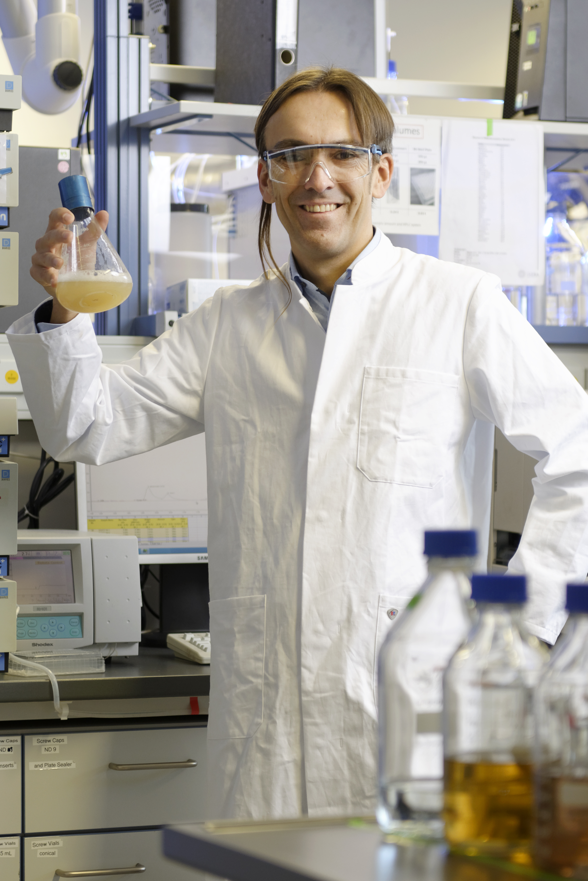


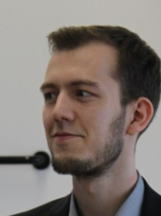
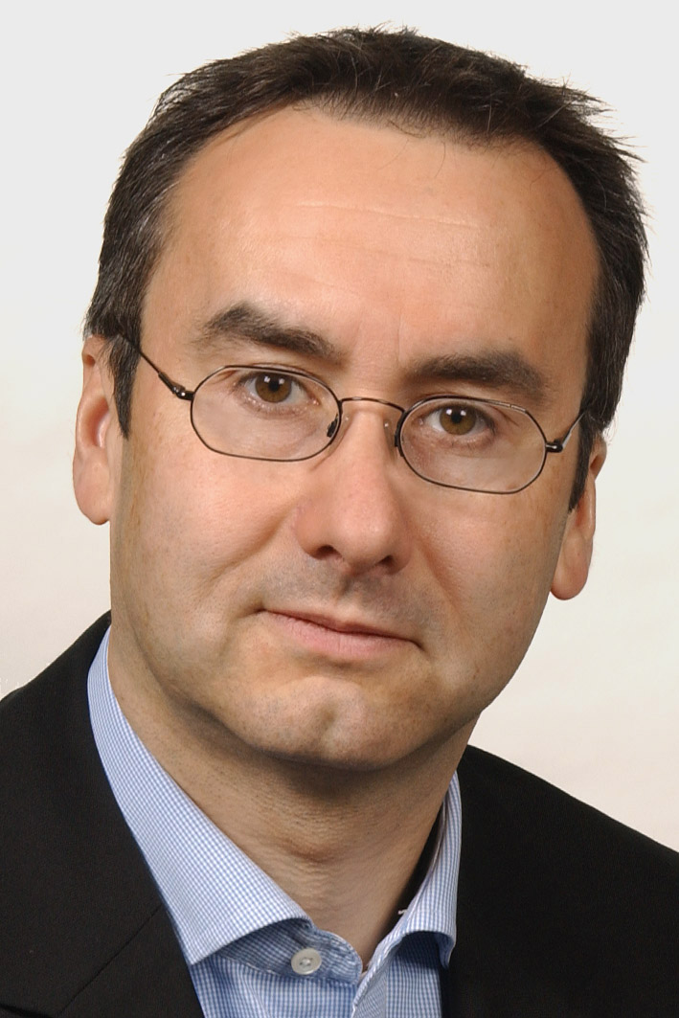
Rafael Schimassek
Katrin Büngener
Iris Broderius
Dr. Nicole Maaßen
Prof. Lars Blank
Funding
Exzelenzinitiative: iStrainML
Exzelencluster 2186: The Fuel Science Center
Prof. Frank Eiden
Jonathan Sturm

